Slide 1
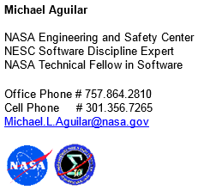
Where Formal Methods Might Find Application on Future NASA Missions
On-Ramps for Formal Methods

Slide 2
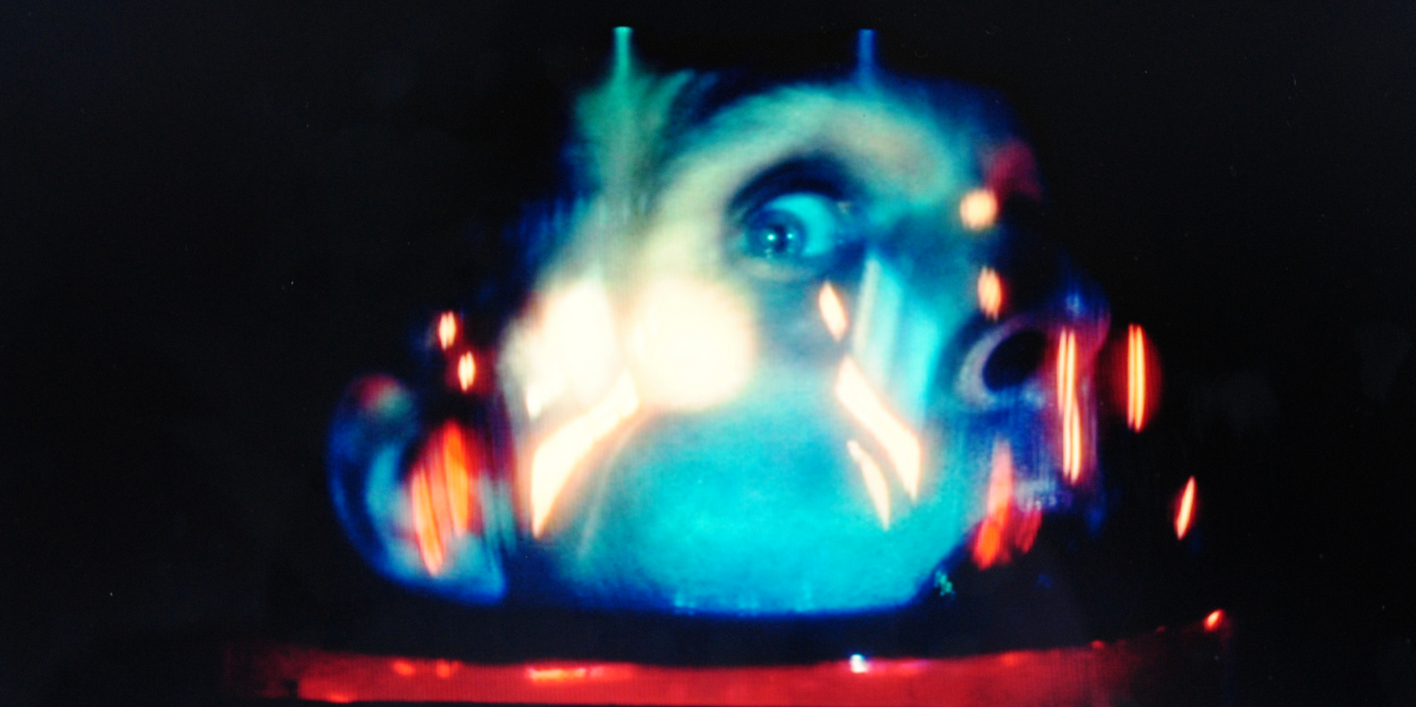
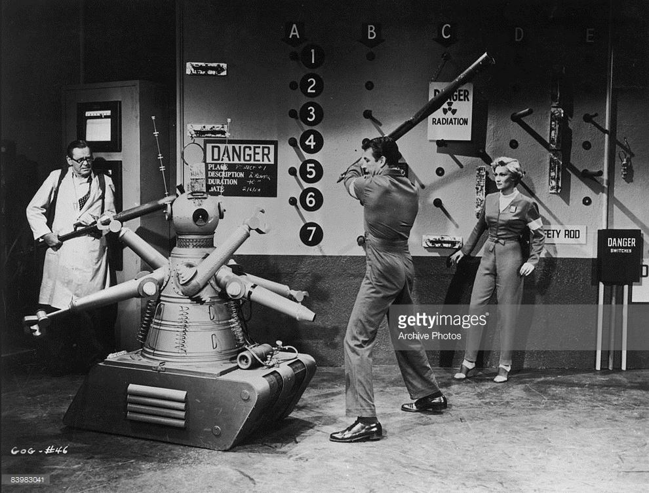
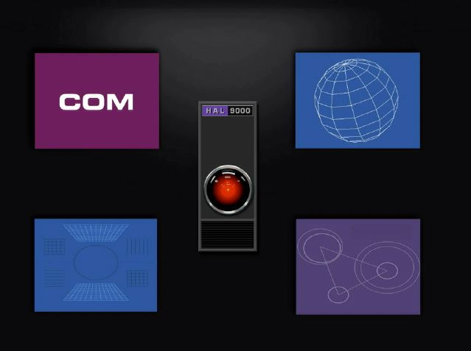
I am not a formal methods expert. Or an AI expert. Or an automation expert.

Slide 3
NASA Engineering and Safety Center (NESC)
Action from Challenger and Columbia Recommendations
“Red” or “Tiger” team support for engineering decisions
NESC Software Discipline Expert
NASA Technical Fellow in Software
My interest in this NASA Formal Methods Symposium is in the advance and enhancement of software validation and verification.

Slide 4
Advanced Automation for Space Missions
NASA Conference Publication 2255, 1980
There is a great deal of theoretical research (and in some cases practical development) in progress at several institutions in the United States and throughout the world. These research and development programs are necessary for the eventual success of the applications described elsewhere in this report. They are also a part of the rationale which has led to NASA's current strong interest in the potential of machine intelligence in space. However, even a vigorous research effort does not necessarily imply an applications development process adaptable to future NASA needs.
Furthermore, the technology-transfer problem is aggravated by the relative scarcity of qualified workers in the Al field. NASA may begin to alleviate this manpower crisis by directly supporting artificial intelligence and robotics research in colleges and universities throughout the United States.

Slide 5
Current State of Software/System Verification “We test it a lot”
For every documented requirement, there is a documented test case
There must be a documented successful systems test to pass verification.
Success or failure of a systems test is determined by engineering and management.
Specific non-reproducible defects remain open after system test.
Defects detected during system test are corrected and then verified by a selected subset of the systems test.
As the software advances from software-only test beds to the deployed/targeted system, less and less of the system is tested.
Specific systems are never tested due to expendables, cost, safety, and schedule.
System of System verification is undefined.
Non-software flight configuration verification. For example: data uploads, code uploads, scripts, conditions, events, and limits verification…

Slide 6
I could use some help with the developing new techniques to support the following:
Software-Only Testing
Hardware/Software Testing
Subsystem Testing
Fault Management Testing
Autonomous Functions Verification
Constraint of Solution Space
Abort Systems
Flight Termination Systems
System of System Integration
Software System Acceptance Test
Failure Prognostication
Human – Machine Interfaces
Tele-operation Mission
Autonomous Mission
Scheduling, Resource, and Expendable management
Ground Operations Support
Sensor Analysis and Fusion
Validation and verification of non-software configuration, scripts, fault-management files and tables

Slide 7
Successful On-Ramp, MBSE Example
Identify specific problem not currently addressed or addressed poorly
Solve a specific problem
Ground, operations, and flight are all in need of support
Scope application of formal method to problem
Scope to succeed
Example Deliveries (reduce budget, increase capability, reduce risk)
Applicable test cases that can be implemented
Constrain system requirements, system design, and system implementation to allow for formal methods
Operational tools to audit and verify system parameters and configuration to support ground operations

Slide 8
Model-Based System Engineering
Problem: Reviews of numerous interface documents across NASA and contractors has been attempted by dividing the document set among a distributed group of busy engineers. The review is expected to identify disconnects, gaps, issues, and clarity of the system interfaces.
Question: Is the above effective or efficient?
NESC Assessment: Using the document set (>75) to construct a single model of the physical and logical communication and software interfaces, and review the interface model.
Did not call it MBSE, called it “comprehensive document review”.
Assessment has continued for years adding interfaces between SLS-MPCV-ESM and the GSDO interfaces. Still continuing today.

Slide 9
NASA Technological Roadmaps (2015) http://www.nasa.gov/offices/oct/home/roadmaps/index.html
More of a Catalog of Possible Missions
“What capabilities does NASA need to maintain to meet these possible missions?”
“What is the timeline to meet the necessary capability?”
‘Automation’ appears in nearly every roadmap

Slide 10
NASA “Tabs”

Slide 12
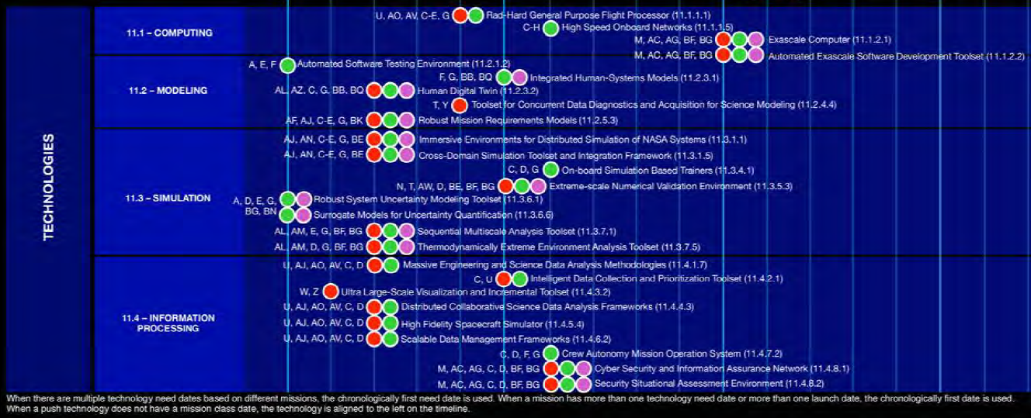
Timeframe (Near Term Technology Example)

Slide 13
Capabilities
Capabilities need to be developed to an advanced Technical Readiness Level (TRLs) so the capability can be applied to a mission.

Slide 14
Generic TRL Definitions
“Mission Funded”
“Valley of Death”
“Capability Funded”

Slide 15
Formal Specification Language
Develop a formal specification language to enable automatic generation of integrated hardware and software artifacts
SOA: Commercial sector and opensource frameworks for creation of applications based on RDF, and ontology editor and knowledge acquisition system, and ontology languages
Current percent of HW/SW system interface artifacts specified by specification language: 10%. TRL-2
Goal to specify almost all system design HW/SW interface artifacts with the specification language :100%. TRL-9

Slide 16
Autonomous Fault Detection
Fault detection and isolation is currently done primarily with hard coded thresholds. New techniques which use data driven and model based analytical techniques to detect anomalous system behavior and isolate probable causes have been demonstrated in some prototype systems.
SOA TRL-5
> 10% false positive anomaly detection; < 2% false negative anomaly detection; Human-in-the-loop needed for fault
identification: < 5% false positive fault identification; < 10% false negative fault identification
Goal TRL 7
< 10% false positive anomaly detection; < 2% false negative anomaly detection; No human-in-the-loop needed for fault
identification: < 5% false positive fault identification; < 10% false negative fault identification

Slide 17
Autonomous Surface Navigation
Technology Challenge:
Assessment of navigation performance under a range of terrain and lighting conditions. Incorporation of higher fidelity models of mobility in traversability assessment and motion planning with limited onboard computation. Assessment of broader range of terrain hazards (geometric and terramechanical hazards) with limited sensing and onboard computation. Online navigation parameter and algorithm tuning based on traverse experience.

Slide 18
Human Intent
Technology Description:
Enables autonomous system to detect, recognize, and/or react to human intent.
Technology Challenge:
Challenges include developing systems to recognize user activity, gaze (direction, target, etc.), gestures (affect, deictic, and iconic), speech, and other elements as indicators of implicit operator intent, behavioral models capable of predicting future operator actions, and planning systems capable of responding appropriately.

Slide 19
Autonomous Systems Human Interface
Technology Description:
Software framework that facilitates coordination, communication, and collaboration between humans and autonomous systems (including robots and software agents).
Technology Challenge:
Challenges include enabling humans and autonomous systems to communicate (conversing about goals, abilities, plans, and achievements) and to collaborate (jointly solving problems).

Slide 20
Ground-Based Fault Forecasting
Technology Current SOA:
Commercial product, Testability, Engineering, and Maintenance System (TEAMS), from QSI, uses a diagnostic reasoner that adapts through learning. Used in test beds at various centers. NASA ARC Inductive Monitoring System (IMS): uses data mining clustering technique to isolate off-nominal interaction between parameters. G2 is an AI expert system demonstrated on the ISS for payload monitoring. It is in use at some commercial satellite facilities for control of formation systems. NASA JPL Spacecraft Health Inference Engine (SHINE) is a high-speed expert system (stateless rule-based system) and inference engine for the diagnosis of spacecraft health.

Slide 21
Integrated Vehicle Health Management
Technology Current SOA:
Uses maintenance information and physics based models to predict future failures. RepAIR project - IVHM for the aerospace industry.
Goal:
Adaptable systems that learn from past experience. Systems that scale with increased complexity. Flexible systems that can be adapted to new missions or mission that undergo changes; Computational cost; Accuracy: 90%
TRL: 6

Slide 22
Distributed Autonomous Coordination
Technology Description:
Provides an infrastructure for distributing autonomous functionalities across platforms.
Technology Challenge:
Challenges due to the heterogeneity of the hardware and software tools that are interfaces. Challenges include validation and verification of the complex agent interactions, and the capability and management of agent system group goal direction.

Slide 23
V&V of Complex Adaptive System
Technology Description: Provides pre-flight verification and validation (V&V) to the level necessary for human safety and reliability and for systems to allow crew independence; provides in-flight V&V following in-the-field system re-configuration.
Technology Challenge: Validation and verification of a changing or evolving system and automated validation and verification on demand.
Technology State of the Art: Current methods explicitly depend on standards, regulations, processes and rigorous examination of the integrated system.
Technology Performance Goal: Automated V&V for robotic systems that are operating in dynamic and changing environments.
Parameter, Value: Type of V&V support: automated hardware and software tools that handle complex systems with numerous configurations and can handle large environmental and operational uncertainties in poorly-modeled environments; In-situ V&V: yes TRL 6

Slide 24
Neural Net Trajectory Planning
Technology Description:
Neural net trajectory planning: genetic algorithm-based trajectory planning.
Parameter, Value:
Since this is done on the ground with powerful computers, the time to perform the mission planning is small. It needs to work on a target flight processor and generate feasible mission plans and converge within 60 seconds. Algorithms and flight software need to be 'bulletproof.'
TRL: 2
Parameter, Value:
Optimized trajectory that meets constraints and converges in less than 60 seconds.
TRL: 7

Slide 25
Extending Autonomy
Technology Challenge: Extending autonomy capability requires: transitioning responsibility from ground to crew (e.g., autonomous procedure execution); automating functions done by people (e.g., procedure automation); expanding autonomy from simple to complex tasks (e.g., from single procedures to managing entire system); assist ground controls in identifying slowly developing trends of data towards off-nominal (or out of family) performance; scaling autonomy from smaller to larger systems (e.g., one power bus to four); clearly displaying and drawing attention to the right things given an extremely large amount of data available; and expanding autonomy to more types of systems (e.g., power, environmental control and life support system (ECLSS), and thermal).
Technology Performance Goal: Protocols and technology to accurately transmit tens of thousands of commands and telemetry items with delays of up to eight minutes (1 way).
Parameter, Value: Transmit commands with time delay: 35,000; Monitor telemetry with a time delay: 90,000 telemetry items; Displays: 750; Manage operational constraints: 500; Perform procedures: 2,000; Mange plans: 100 activities per day; Manage fault conditions: 9,000 TRL 6

Slide 26
Hazard Detection
Technology Description: Enables the identification and location determination of landing hazards using just-acquired passive and/or active imaging. Also predicts and corrects landing location errors relative to a changing target from the position and hazard detection components.
Technology Challenge: Challenges include the need to detect and identify a wide variety of potential landing hazards, such as slopes and rocks, autonomously during descent, and in the presence of dust.
Technology State of the Art: Mars Science Laboratory (MSL) Terminal Descent sensor; terrain-relative localization using Lander Vision System (LVS); Autonomous Landing and Hazard Avoidance Technology (ALHAT).
Technology Performance Goal: Demonstration of robust hazard detection and avoidance over a large variety of potential hazards.
Parameter, Value: Object detection: 2 cm range accuracy Velocity accuracy: 1 cm/sec
TRL 6

Slide 27
Digital Twin
Technology Description: The digital representation of the flight system with comprehensive diagnostic and prognostic capabilities to enable efficient development and certification as well as safe, autonomous operation throughout the service life of system.
Technology Challenge: Development of a digital representation of the entire spacecraft through the integration of high-fidelity and certification models, service life inspection and health monitoring assessment data, and life extension prediction methods in a real-time framework.
Technology State of the Art: Not currently being worked.
Parameter, Value: Low level of confidence in analytical models, high reliance on test results.
TRL 1
Technology Performance Goal: Autonomous predictions of mechanism failure modes.
Parameter, Value: High level of confidence in analytical models, low reliance on test results.
TRL 5

Slide 28
Resource Scheduling
Technology State of the Art: Continuous Activity Scheduling, Planning, Execution, and Replanning (CASPER): Autonomous Sciencecraft Experiment (ASE) for photo observation planning and uses space craft command language for plan execution. NASA’s HAL 9000: real-time distributed autonomous planning engine system, nine integrated engines (Mission Manager; power; environmental control and life support systems; communications; guidance, navigation, and control; propulsion; safety; robotics activity) utilizing Timeliner for plan and activity execution. Nexus planning system prototype: developed at NASA 20 years ago. Explored the challenge of resource modeling to support NASA’s request oriented scheduling engine.
Technology Performance Goal: Provide planning and scheduling systems to optimize the use of resources during operations, from the execution of daily tasks to working within all constraints and requirements to plan longer-range activities, such as launch manifests and facility utilization.
Parameter, Value: In relevant environment: Number of Plan Models: 1,000s; Number of Scheduled Activities: 1,000s; Difficulty of Model Definition Effort (scale of 1 (low) to 5 (high)): 2
TRL 6

Slide 29
Activity Scheduling
Technology Description: Activity scheduling primarily determined through system learning (prior good answers, fuzzy logic, and dynamic rule creation).
Technology Challenge: Improvements in system learning and its application (prior good answers, fuzzy logic, and dynamic rule creation). Accurate information on resource status (availability, quantity). Integration of plans with plan execution via computer software with appropriate feedback to the plan.
Technology State of the Art: A commercially-built artificial intelligence (AI) system is capable of answering questions posed in natural language. It is a massive parallel processing computer with a terabyte database and includes highly-focused question-answering capability around hundreds of topics (open domain question answering). The system learns through generalization without specific programming.
Parameter, Value: Effort to perform tasks (scale of 1 (low) to 5 (high)): 1
TRL 6
Technology Performance Goal: Provide planning and scheduling systems to optimize the use of resources during operations, from the execution of daily tasks to working within all constraints and requirements to plan longer-range activities, such as launch manifests and facility utilization.
Parameter, Value: Number of Plan Models: 1,000s; Number of Scheduled Activities: 1,000s; Level of difficulty of Model Definition Effort (scale of 1 (low) to 5 (high)): 1
TRL 6

Slide 30
Autonomous Repair
Technology Description: Launch vehicles and ground systems monitor and assess their own health to identify and repair off-nominal conditions and/or detect timing that might lead to crew abort or flight termination.
Technology Challenge: Challenges include verifying model-based systems and scaling model-based techniques.
Technology State of the Art: Model-based autonomy is the creation of long-lived autonomous systems that are able to explore, command, diagnose, and repair themselves using fast, common sense reasoning.
Parameter, Value: Time to detect off-nominal behavior: hours; Time to identify faults: hours; Time to diagnose faults: hours.
TRL 4
Technology Performance Goal: Continuous monitoring of all critical areas for off-nominal behavior plus continuous verification of correct behavior; near real-time detection, identification, and diagnosis of faulty components.
Parameter, Value: Time to detect off-nominal behavior: seconds; Time to identify faults: minutes; Time to diagnose faults: tens of minutes.
TRL 4

Slide 31
Autonomous Safety Assurance
Technical Challenge Description: Develop verification and validation techniques to instill confidence that new technologies are as safe as (or safer than) the current system and provide a cost-effective basis for assurance and certification of complex civil aviation systems.
Research Theme: Validation, Verification, Testing, and Evaluation: Application of assurance technologies to validate performance of autonomous systems in a variety of known (i.e. conceivable) operational scenarios; extension of traditional verification and validation techniques to ensure trust and confidence in the performance of machine learning, and sense-making autonomy functions capable of adapting to conditions of the unknown unknown type.
Technical Challenge State of the Art: Developing formal methods for assuring flight-critical systems, researching and promoting use off formal methods to develop safety cases acceptable for certification.
Parameter, Value: Research into validated tools for assurance of flight-critical systems.
TRL 2
Technical Challenge Performance Goal: Demonstrate expedited deployment of flight-critical systems within NextGen simulated environment.
Parameter, Value: Existence of validated tools for assurance of flight-critical systems.
TRL 6

Slide 32
NASA Environment
Budget and Priority
Funding of major missions is priority
Budget challenges reduce funding for smaller projects
Major Programs vs. Minor Projects
Reduced scope as on-ramp for formal method techniques on major programs
Small projects as on-ramp for formal method techniques increasing the small project importance
Reduced verification and testing due to scale, budget, and schedule
How can this community provide and plan the gap between the initial TRL and the goal TRL? What does this community need to support these capabilities?

Slide 33
Possible NASA Resources
Raw Telemetry Data
Historical hardware data stream from ISS
Historical hardware failure data from ISS
Historical hardware data stream from Kepler
Historical hardware failure data from Kepler
Raw Audio Stream
ISS EVA Audio
Hubble Repair Audio
Raw Science Data
Mars terrain data
Exoplanet data
Earth Science data
Video Data
Rendezvous and docking
Terrain environments
Ground Operations Environment
Planning and scheduling
Configuration and uploads

Slide 34
Session: Breakout

Slide 35
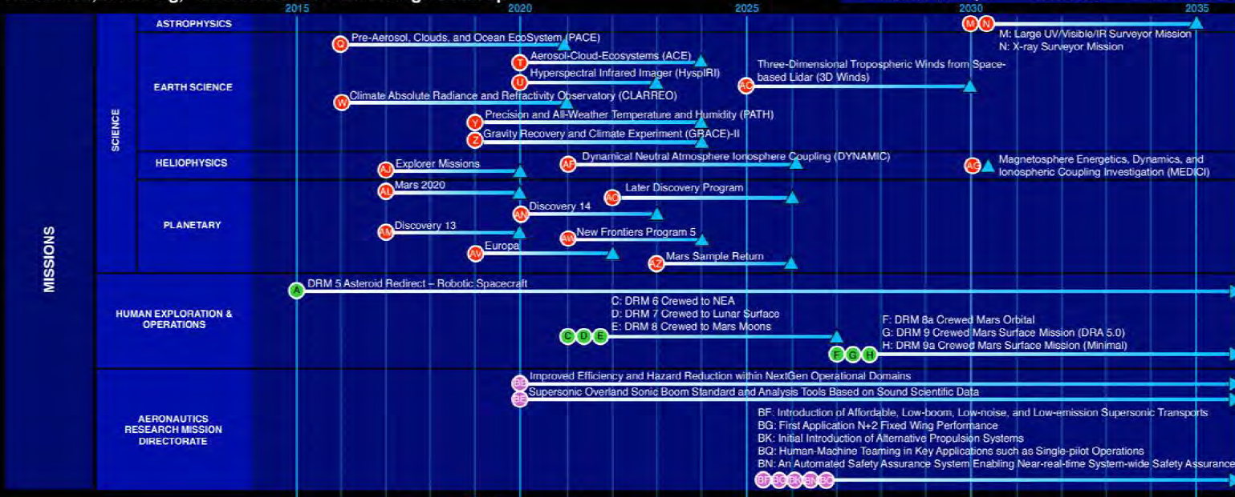
Timeframe (Near Term Missions Example)

